Slide 1

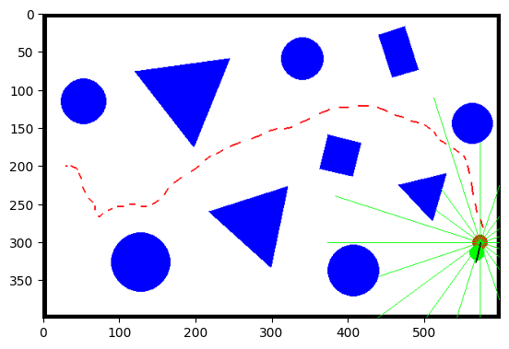
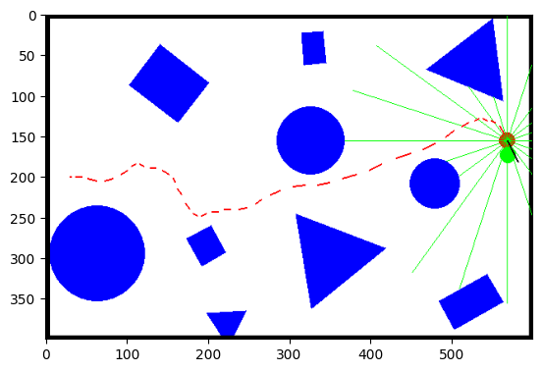
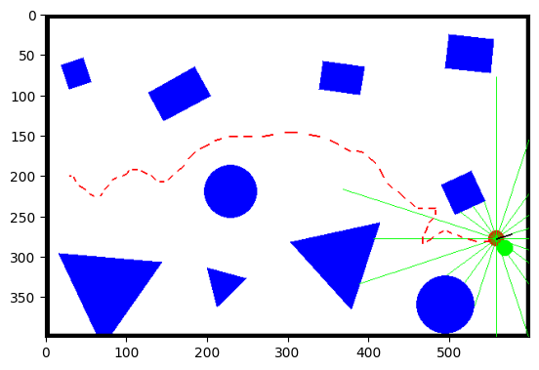
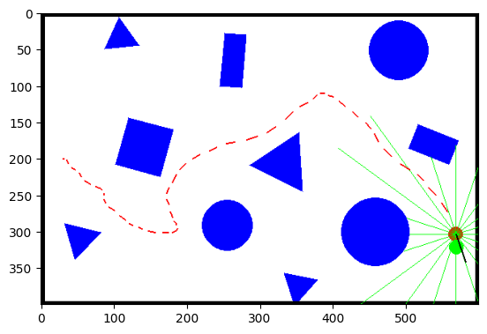
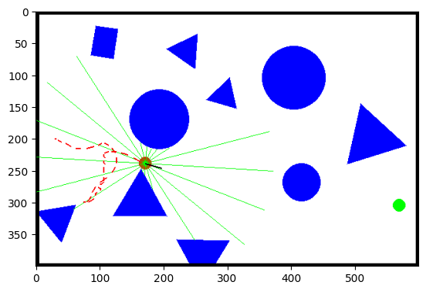
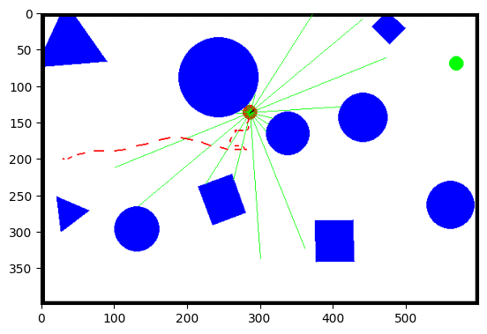



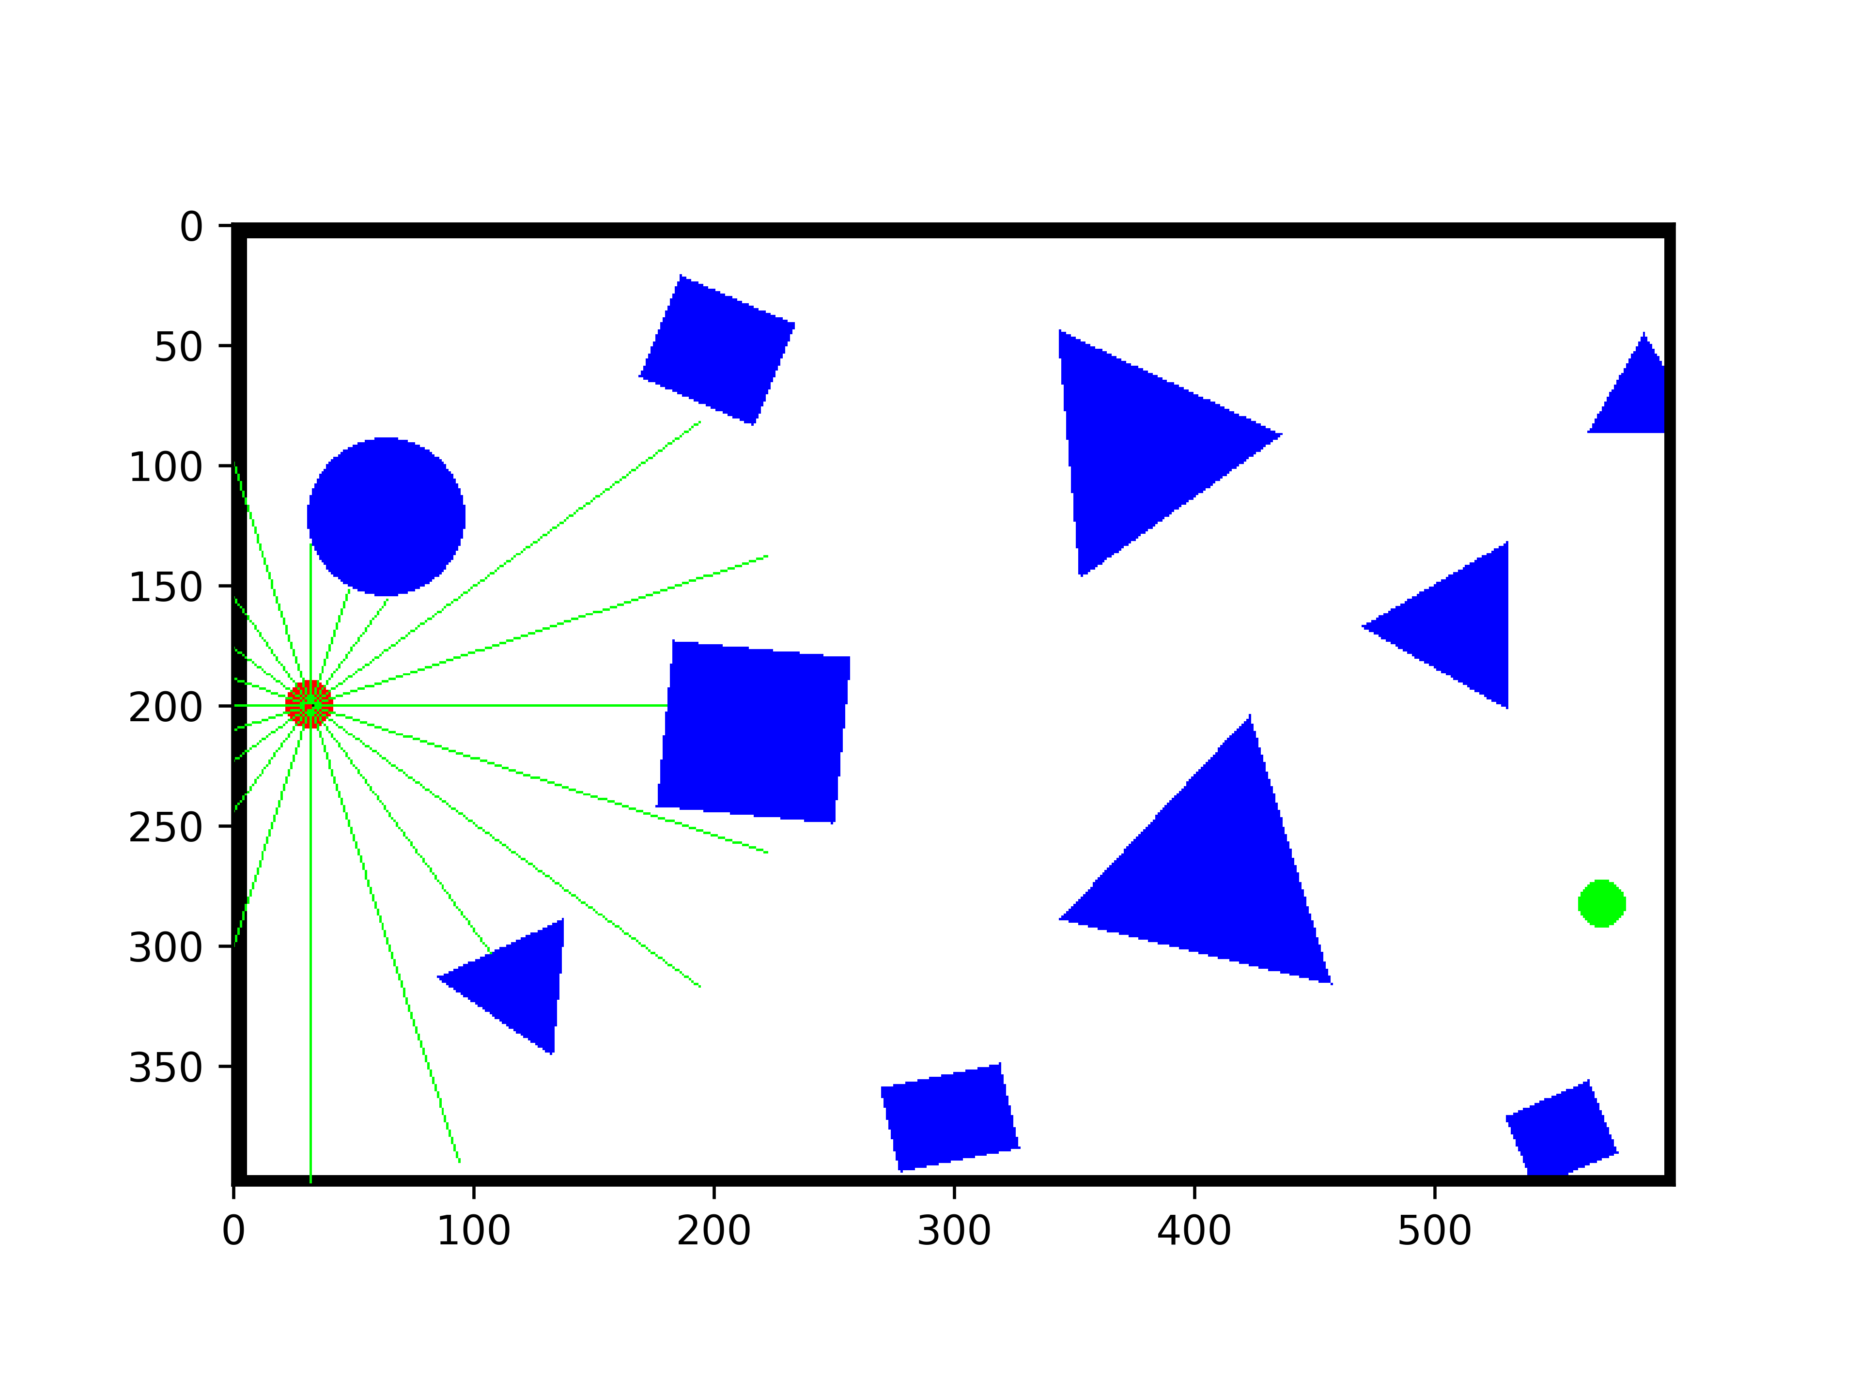

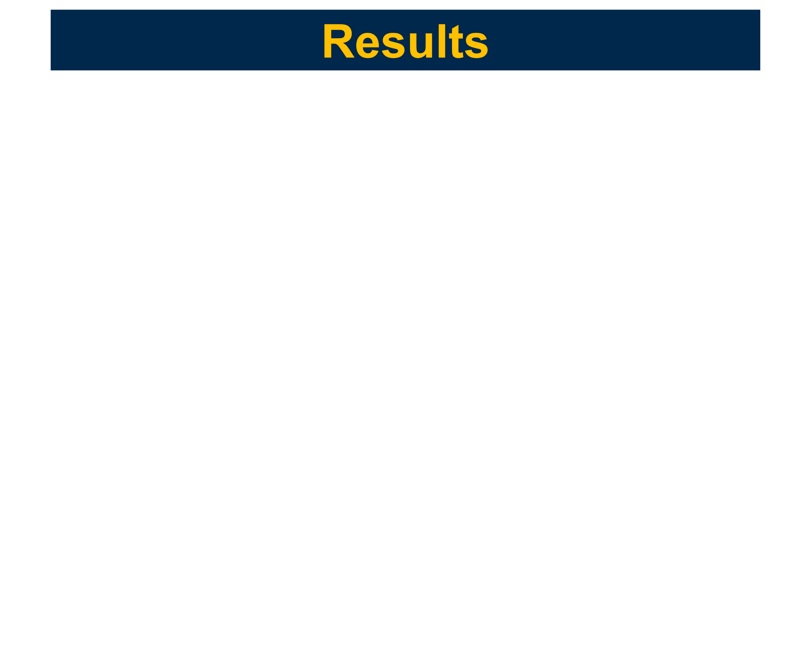
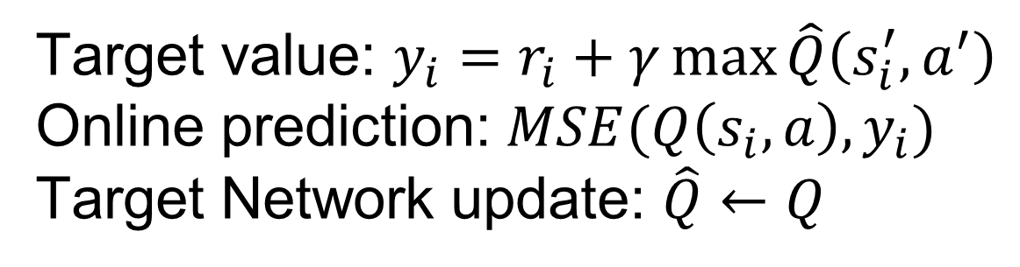
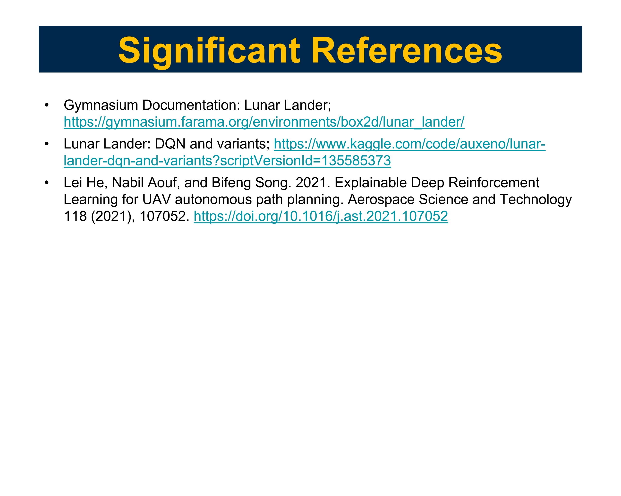
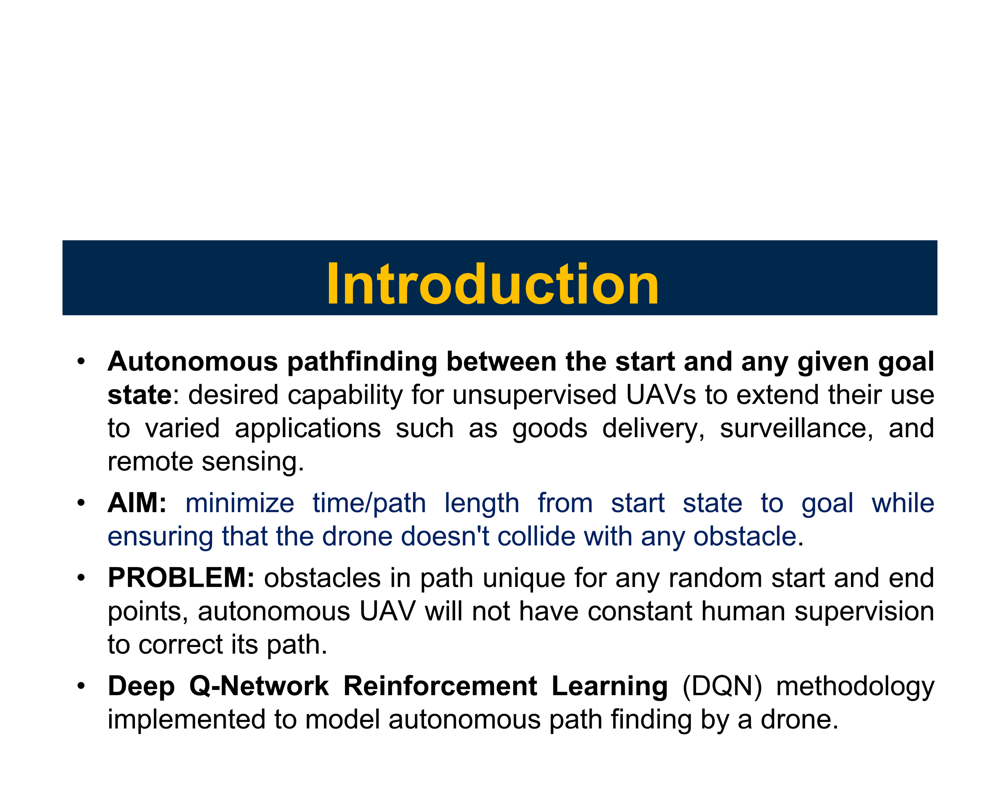

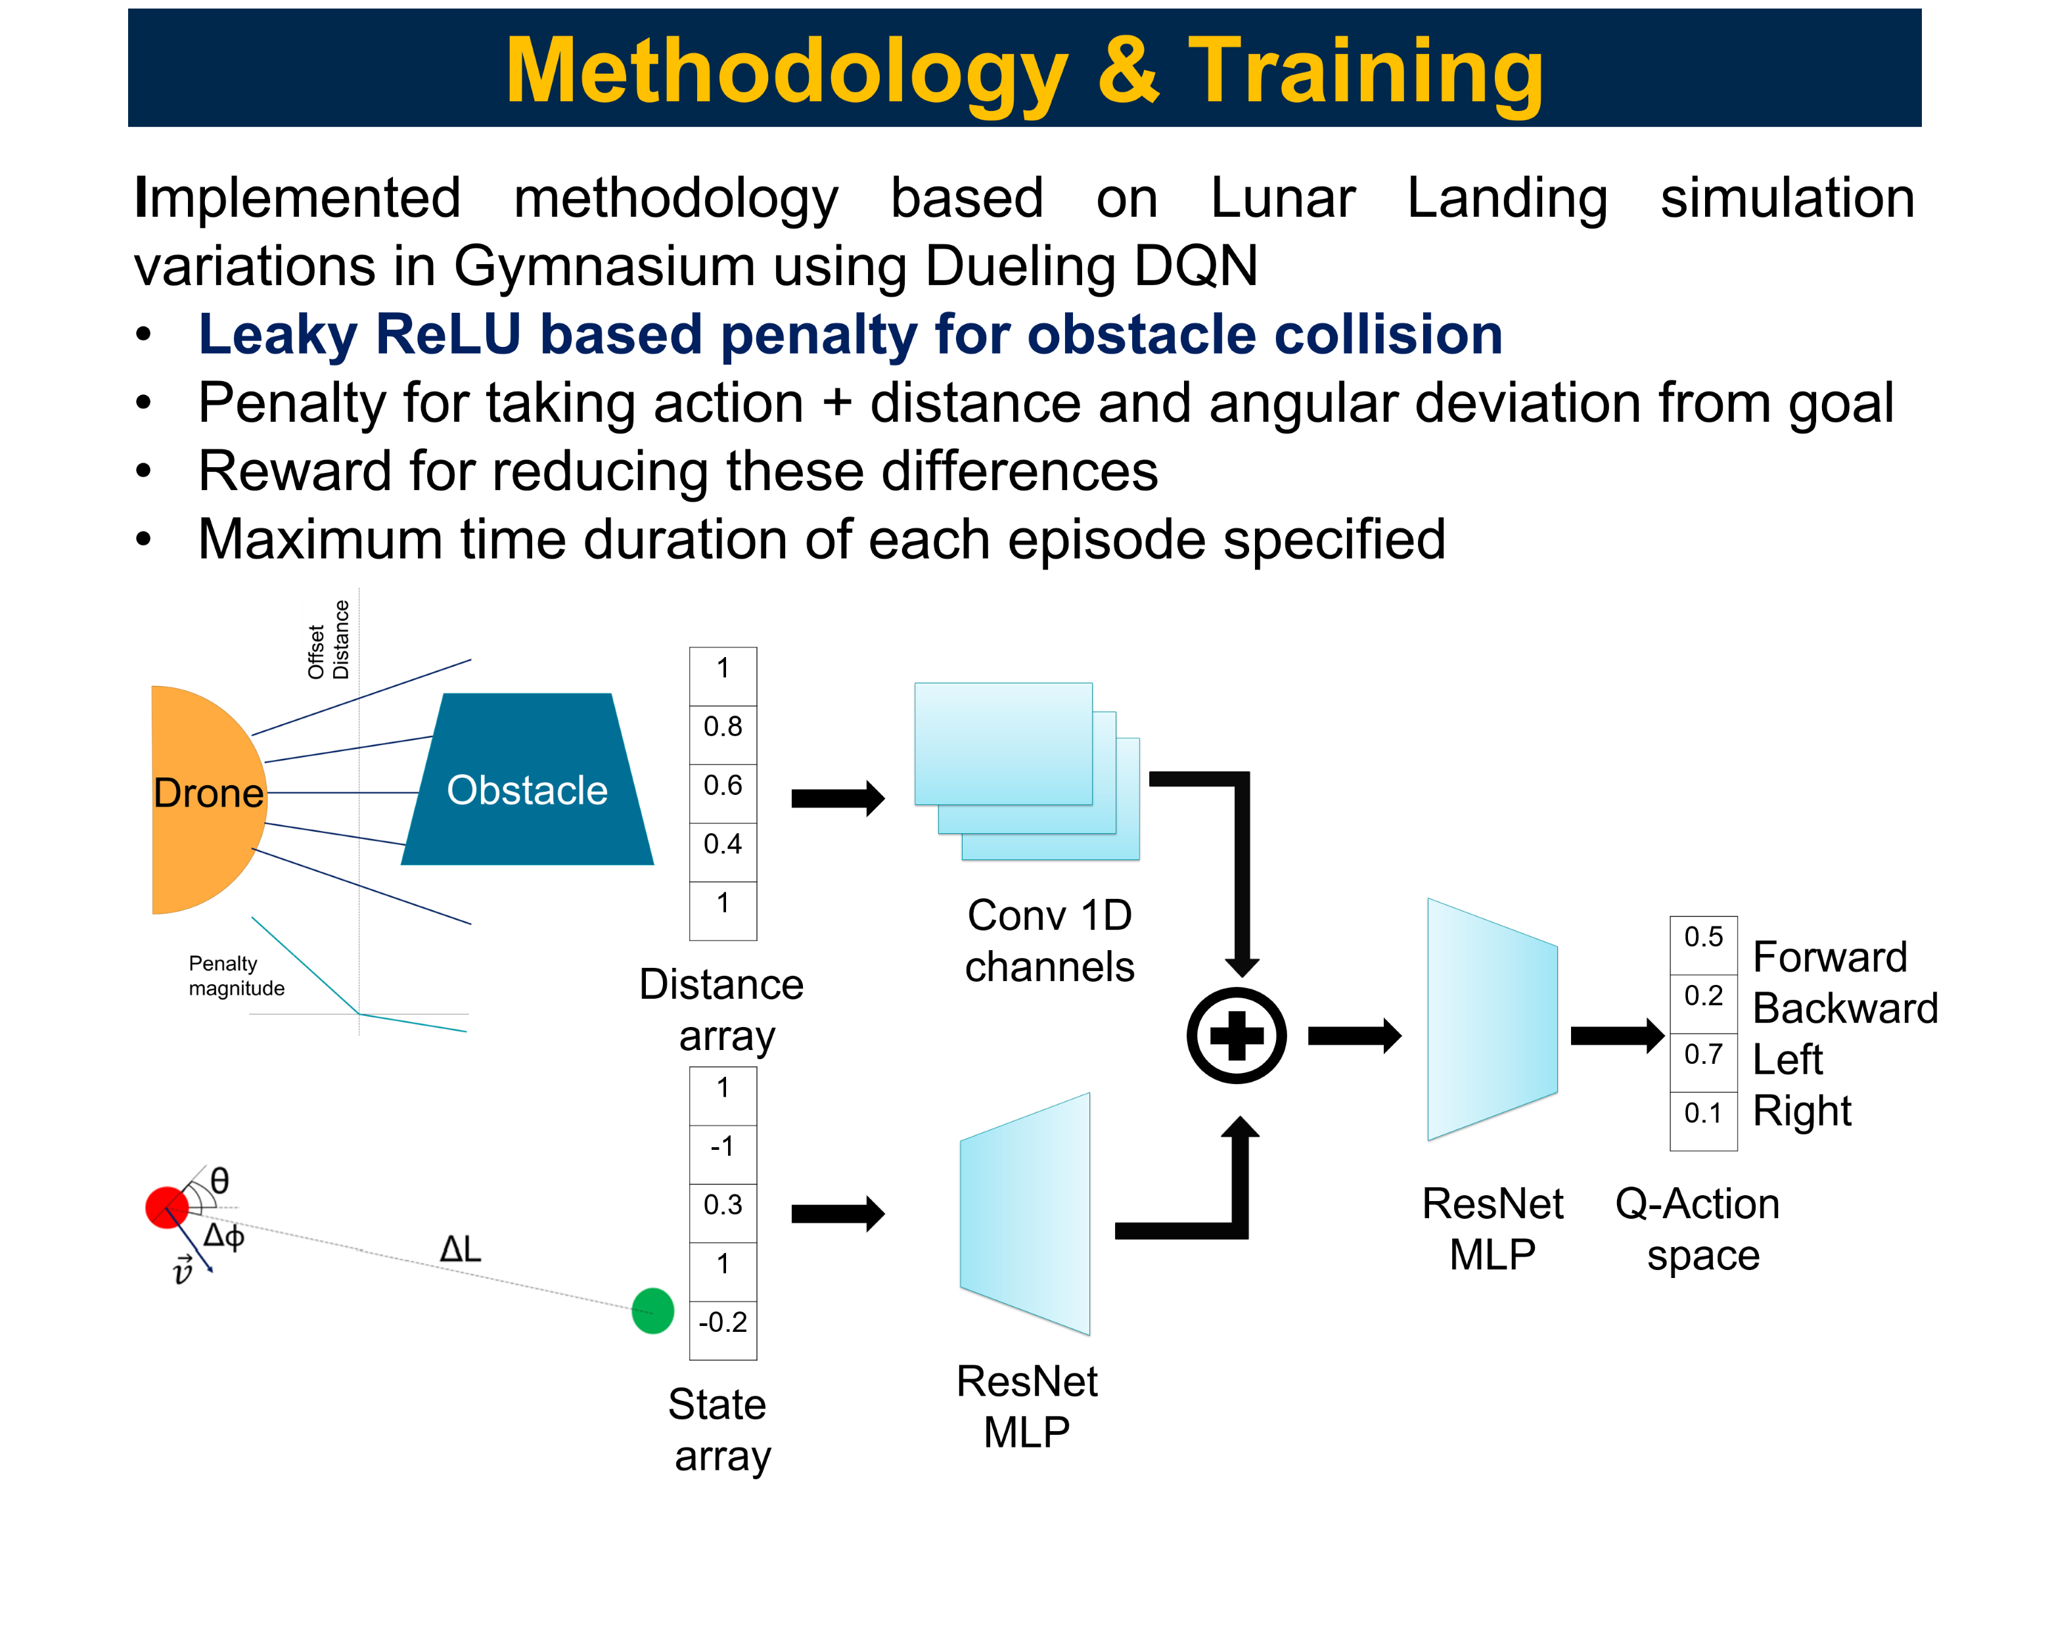
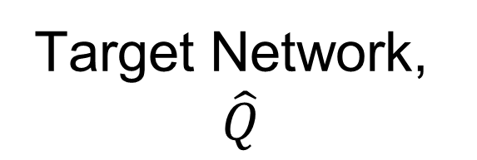
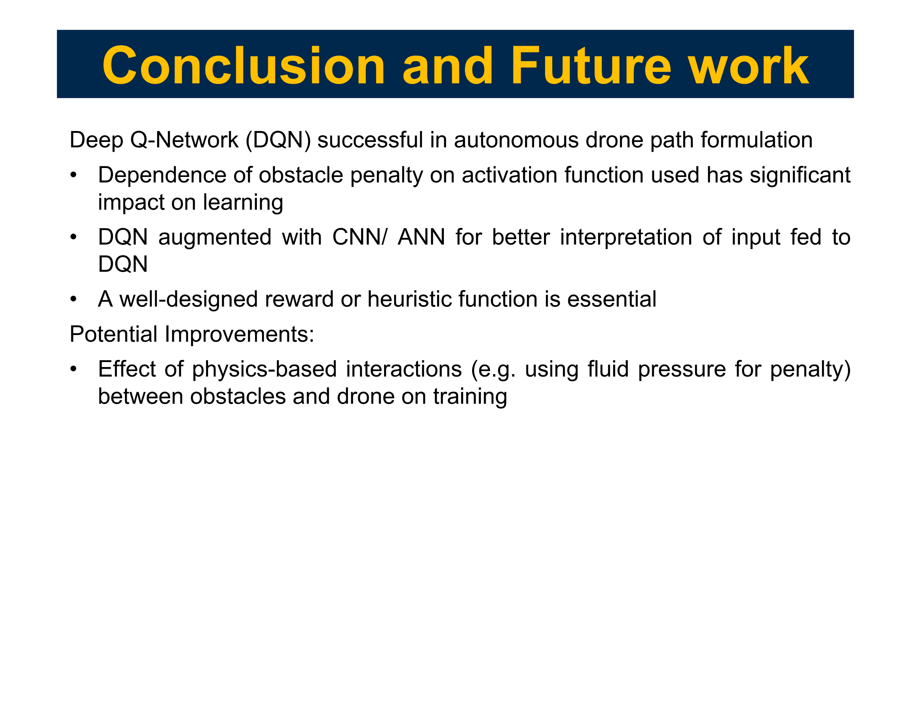
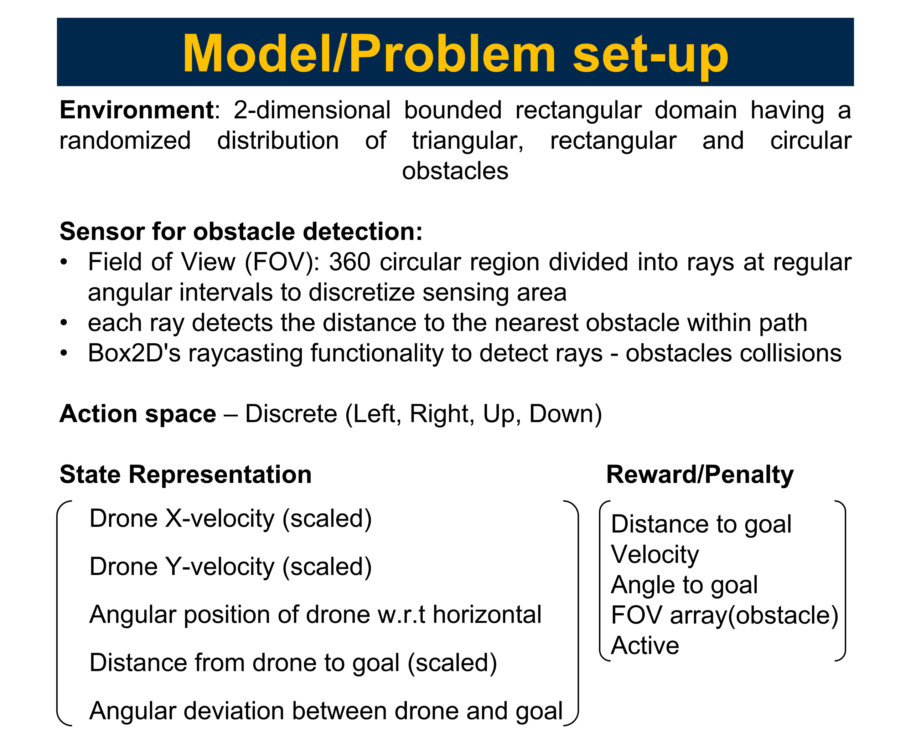
EECS 592: Autonomous Path Finding for Drones using Deep Reinforcement Learning
YILIN ZHUANG and MOON BAKAYA HAZARIKA
Department of Aerospace Engineering, University of Michigan Ann Arbor
Memory buffer
Online Network, $$Q$$
Target Network, $$\hat{Q}$$
Success rate after 1000 episodes: 66%
Target value: $y_{i}=r_{i}+γ\max{\hat{Q}\left(s_{i}^{′},a^{′}\right)}$
Online prediction: $MSE(Q\left(s_{i},a\right),y_{i})$
Target Network update: $\hat{Q}←Q$
~10 randomly generated obstacles, min. clearance
Agent: fixed starting point; Goal: uniform sampled y

Slide 2
Introduction
Autonomous pathfinding between the start and any given goal state: desired capability for unsupervised UAVs to extend their use to varied applications such as goods delivery, surveillance, and remote sensing.
AIM: minimize time/path length from start state to goal while ensuring that the drone doesn't collide with any obstacle.
PROBLEM: obstacles in path unique for any random start and end points, autonomous UAV will not have constant human supervision to correct its path.
Deep Q-Network Reinforcement Learning (DQN) methodology implemented to model autonomous path finding by a drone.

Slide 3
Model/Problem set-up
Environment: 2-dimensional bounded rectangular domain having a randomized distribution of triangular, rectangular and circular obstacles
Sensor for obstacle detection:
Field of View (FOV): 360 circular region divided into rays at regular angular intervals to discretize sensing area
each ray detects the distance to the nearest obstacle within path
Box2D's raycasting functionality to detect rays - obstacles collisions
Action space – Discrete (Left, Right, Up, Down)
State Representation Reward/Penalty
Drone X-velocity (scaled)
Drone Y-velocity (scaled)
Angular position of drone w.r.t horizontal
Distance from drone to goal (scaled)
Angular deviation between drone and goal
Distance to goal Velocity Angle to goal FOV array(obstacle) Active

Slide 4
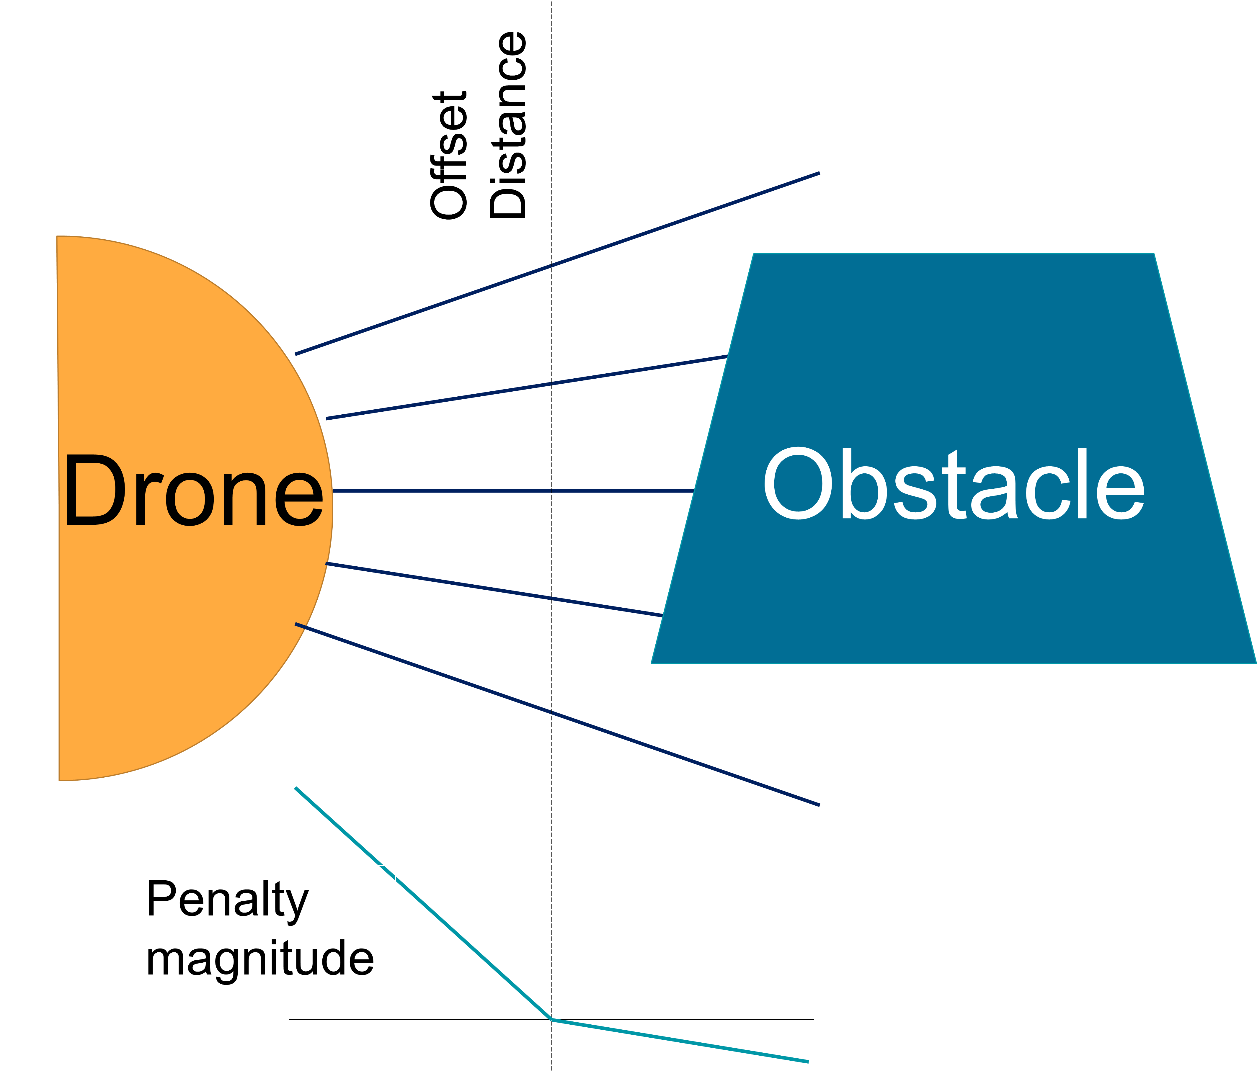
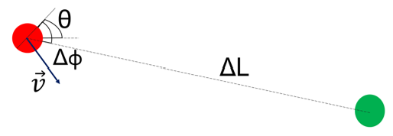
Methodology & Training
Implemented methodology based on Lunar Landing simulation variations in Gymnasium using Dueling DQN
Leaky ReLU based penalty for obstacle collision
Penalty for taking action + distance and angular deviation from goal
Reward for reducing these differences
Maximum time duration of each episode specified
1
0.8
0.6
0.4
1
Conv 1D channels
0.5
0.2
0.7
0.1
Distance array
Forward Backward Left Right
1
-1
0.3
1
-0.2
ResNet MLP
Q-Action space
State array
ResNet MLP

Slide 5
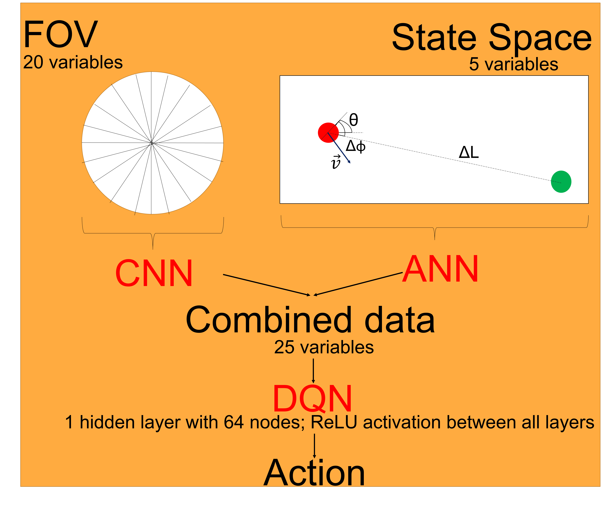
Learning Methodology

Slide 6
Results

Slide 7
Conclusion and Future work
Deep Q-Network (DQN) successful in autonomous drone path formulation
Dependence of obstacle penalty on activation function used has significant impact on learning
DQN augmented with CNN/ ANN for better interpretation of input fed to DQN
A well-designed reward or heuristic function is essential
Potential Improvements:
Effect of physics-based interactions (e.g. using fluid pressure for penalty) between obstacles and drone on training

Slide 8
Significant References
Gymnasium Documentation: Lunar Lander; https://gymnasium.farama.org/environments/box2d/lunar_lander/
Lunar Lander: DQN and variants; https://www.kaggle.com/code/auxeno/lunar-lander-dqn-and-variants?scriptVersionId=135585373
Lei He, Nabil Aouf, and Bifeng Song. 2021. Explainable Deep Reinforcement Learning for UAV autonomous path planning. Aerospace Science and Technology 118 (2021), 107052. https://doi.org/10.1016/j.ast.2021.107052

Slide 9
Offset Distance
Offset Distance
Obstacle
Drone
Penalty magnitude
State Space: [v_{x} v_{y} θ ΔL Δφ]

Slide 10
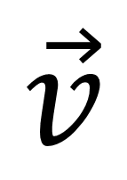
FOV
State Space
20 variables
5 variables
θ
Δφ
ΔL
$$\vec{v}$$
CNN
ANN
Combined data
25 variables
DQN
1 hidden layer with 64 nodes; ReLU activation between all layers
Action

